Slide 1
Neural Network
NN

Slide 2
Model Training & Model Testing
Actually it's not related to NN but it's common for ML industry.
It has low impact on learning rate and the number of features of each example if our data has been very large.
Image with 50*50 has 2500 feature on gray scale.
What about your image size !!! it's so bigger and linear model can not catch the edges and important things between these features .
What about 2500 feature in Non-linear like polynomial function !
What about Training of 1000 image !

Slide 3
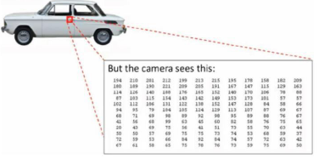
Image Example
Each pixel has a number which brightness of this pixel in the image.
It's different from RGB to Grayscale.
Each pixel is known as one feature in Grayscale
Each pixel is three number in RGB.

Slide 4
NN Neural Network
It's some of idea about how our brain recognize things.
Mimice of human brain works.
We know as example before its an image of car. How computer recognize it.

Slide 5
Neural Rewiring Experiment
Neurons of brain try to recognize thing even with different source.
Dandrite as inputs
Axon as output
A lot of Neurons try to take Decision.
Think of your hand close to something with high temperature.
Dandrite as that thing with high temperature.
Millions of Neurons processing these inputs and.
Axon sends as output of keep your hand away of this thing.

Slide 6
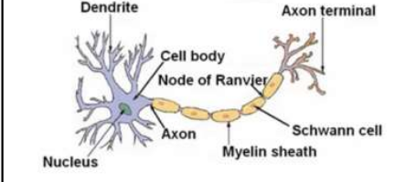
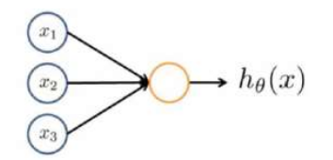
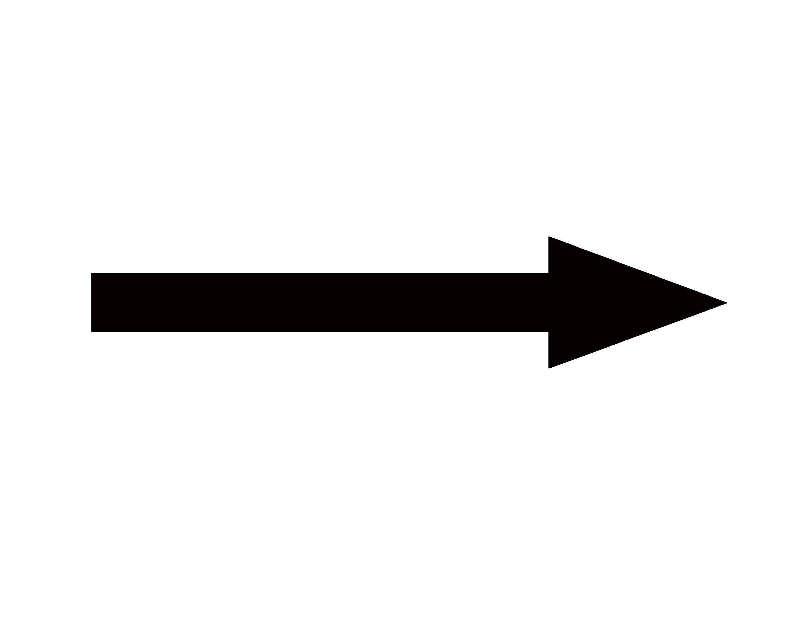
NN Neural Network

Slide 7
Mapping Terminology
Dendrites = inputs Layer = features
Axons = output Layer = hypothesis function
Processing = Hidden Layers = intermediate layers
Tehats = Weights
B = Bias Units
Neurons = Units = Nodes

Slide 8
Terminology To Graph
a²₁ = Node 1 of layer 2
x =a¹
a¹₂ = Node 2 of layer 1
a²
y = a³
Θ²₁₁
Θ²₁₂
a²₂ = Node 2 of layer 2
Θ¹₂₃
Θ¹₁₃
Input Layer
Hidden Layer
Output Layer

Slide 9
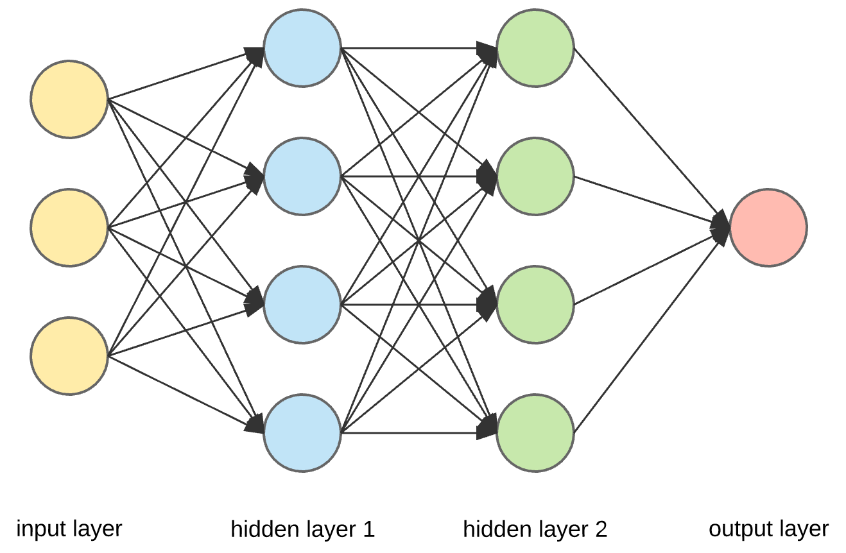
Different NN With 2 hidden Layers

Slide 10
Terminology
x = a(activation value) = features
h_{Θ}(x) = output = Sigmoid if Classification Problem
z = ΘX
Weights = Thetas = Parameters
a = g(z) = g(Θx)
L = Layer
K = Unit = Node of layer
x¹ = a¹ = input layer work as activation layer for features.
Always superscript is define the layer and subscript define which Neuron or Node is.
a^{j}_{k} = Activation of Node k in layer j
a²₁ = node 1 of layer 2
Weights = Nodes of Layer L * Nodes of Layer L - 1.
a² = All nodes of Layer 2
Θ²₁₂ = this weigh is of layer 2 node 2 and going to layer 3 node 1, and that of what we said above about Weights.
Θ² = Weights of Layer 2 that leads to Layer 3.

Slide 11
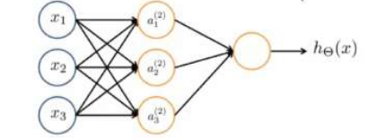
Math Behind NN
a²₁ = g(Θ¹₁₀x¹₀ + Θ¹₁₁x¹₁ + Θ¹₁₂x¹₂ +Θ¹₁₃x¹₃)
a²₂ = g(Θ¹₂₀x¹₀ + Θ¹₂₁x¹₁ + Θ¹₂₂x¹₂ +Θ¹₂₃x¹₃)
a²₃ = g(Θ¹₃₀x¹₀ + Θ¹₃₁x¹₁ + Θ¹₃₂x¹₂ +Θ¹₃₃x¹₃)
Noticed that layer number is fixed while the node number change as theta of each arrow.
a³₁ = g(Θ²₁₀a²₀ + Θ²₁₁a²₁ + Θ²₁₂a²₂ +Θ²₁₃a²₃)

Slide 12
Weights
The damnation of Matrix that hold weights is number of neurons in next layer * number of neuron in that layer + (1 which bias unit)
Θ¹ = weights of first layer that lead to second layer.
Θ¹ = 3 * 4
x¹ = 4 * (1 which is x₀ = 1 for Matrix implementation).

Slide 13
Vectorize The Equation
a²₁ = g(Θ¹₁₀x¹₀ + Θ¹₁₁x¹₁ + Θ¹₁₂x¹₂ +Θ¹₁₃x¹₃) Equal to:
a² = g(Θ¹X¹ ) = (3*4) dot (4*1) = (3*1) = g(z¹), then output layer.
a³₁ = g(Θ²₁₀a²₀ + Θ²₁₁a²₁ + Θ²₁₂a²₂ +Θ²₁₃a²₃) = Equal to:
a³ = g(Θ²a²) = g(z²) and z² = Θ²a².

Slide 14
Construct Our Weights
a²₁ = g(Θ¹₁₀x¹₀ + Θ¹₁₁x¹₁ + Θ¹₁₂x¹₂ +Θ¹₁₃x¹₃)
a²₂ = g(Θ¹₂₀x¹₀ + Θ¹₂₁x¹₁ + Θ¹₂₂x¹₂ +Θ¹₂₃x¹₃)
a²₃ = g(Θ¹₃₀x¹₀ + Θ¹₃₁x¹₁ + Θ¹₃₂x¹₂ +Θ¹₃₃x¹₃)
The +1 comes from the addition in Θ^{(j)} of the "bias nodes," x₀​ and Θ₀^{(j)}. In other words the output nodes will not include the bias nodes while the inputs will, so its 3*4 because if j = units so Θ = S_{j+1} * S_{j} + (1 bias).
Θ¹₁₀ Θ¹₁₁ Θ¹₁₂ Θ¹₁₃
Θ¹₂₀ Θ¹₂₁ Θ¹₂₂ Θ¹₂₃
Θ¹₃₀ Θ¹₃₁ Θ¹₃₂ Θ¹₃₃
Θ¹ =

Slide 15
Transform The Equation
We are multiplying our matrix Θ^{j-1} with dimensions S_{j} * (n+1) where S_{j} is the number of our activation nodes) by our vector a^{j-1} with height (n+1). This gives us our vector z^{(j)} with height S_{j}. Now we can get a vector of our activation nodes for layer j as follows:
a^{j} = g(z^{(j)})
Where our function g can be applied element-wise to our vector z^{(j)}.
Setting x=a¹ , we can rewrite the equation as:
z^{(j)} = Θ^{j-1}*a^{j-1} means the whole layer neurons of layer j is equal to weights of previous layer multiply by the activation we get from previous layer.
Then we get g(z) as our new activation for current layer, then go to next layer.

Slide 16
Logical Operator Example
X | Y | Output
1 | 1 | 1
1 | 0 | 0
0 | 1 | 0
0 | 0 | 0
To know how the neural network actually work it's fine to take example of simple logical operator (AND) with simple NN.
So Θ¹ = 1*3(S_{j+1}* S_{j} +1), and let us assume it's values are [-30, 20, 20].
Let x¹ = [1 1 1], so z^{j} = Θ¹ x¹ = -30 + 20 + 20 = 10, then g(z) = 1/(1+e^{-z} )= approximate to 1,
Change x1 and x2 then it will be 0 1,0 or 0,1 or 0,0 then the result will be 0.
Bias Unit
Θ¹₁₀
Θ¹₁₁
Y_hat = h_x = a²
Θ¹₁₂

Slide 17
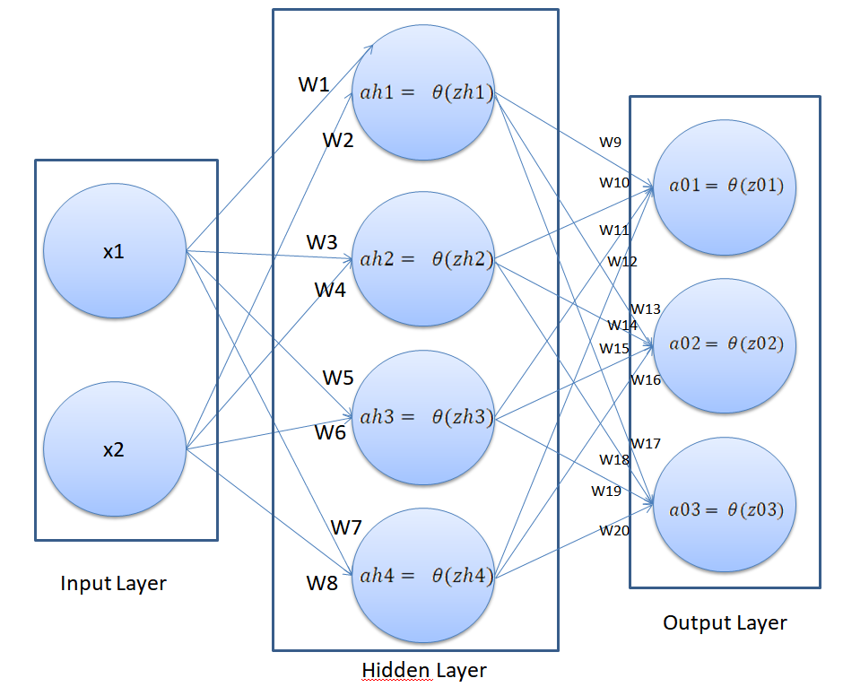
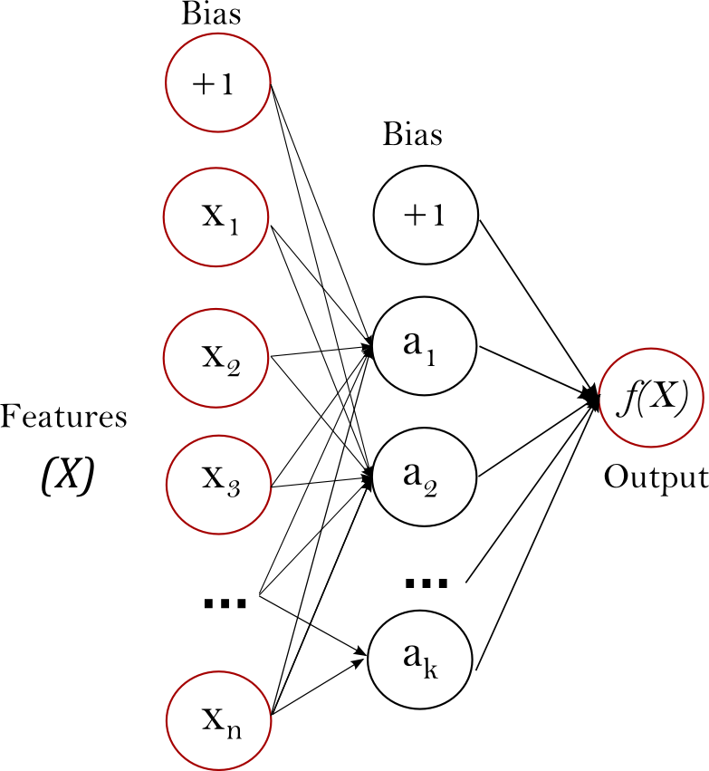
Binary & multi classification NN

